Slide 1


Multi-Asset Financial Time-Series Forecasting
A Transformer-Based Approach for Stock & Crypto Prediction
GROUP MEMBERS
Hamza Shahid • Tariq Jamil • Hottam Ud Din
PRESENTED TO
Ma'am Afsheen Khalid

Slide 2


Project Overview
Unified Forecasting Model
This project builds a unified Transformer-based model to predict future returns for multiple assets (stocks and cryptocurrencies) simultaneously.
Learns shared financial patterns across assets.
Uses Asset Embeddings to retain asset-specific identity.
Objective: Use past 30 days to predict next 5 days.

Slide 3




The Challenge & Solution
The Problem
Our Solution
Financial markets are inherently noisy, non-stationary, and highly volatile. Traditional models often struggle to generalize across different market regimes.
We frame the problem as a supervised time-series forecasting task using a Transformer Encoder.
•
Captures long-term dependencies.
"How can we accurately predict short-term future returns for multiple assets using historical data?"
•
Scales across many assets effectively.
•
Utilizes embeddings to distinguish between asset types (e.g., Crypto vs. Tech Stock).

Slide 4
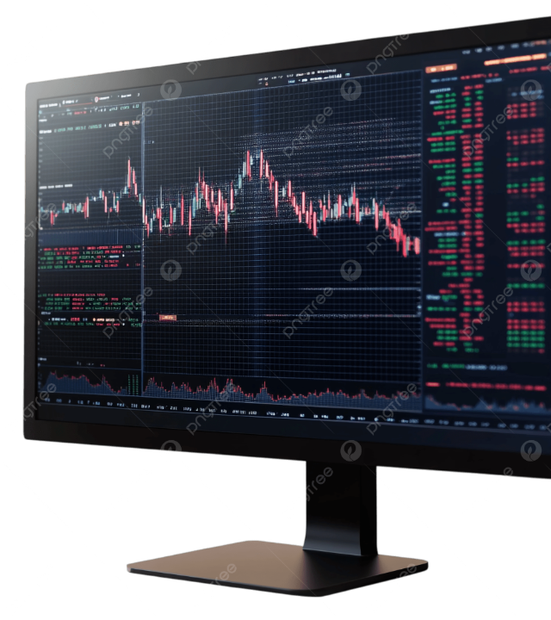
Data Collection
Source & Period
Data collected via Yahoo Finance API covering a 10-year period (Jan 1, 2015 – Jan 1, 2025). This covers multiple market regimes including bull markets and crashes.
Assets Tracked
AAPL
MSFT
GOOG
AMZN
BTC-USD
ETH-USD

Slide 5









Why Predict Returns?
We chose to predict Returns instead of raw Prices. This is a crucial design choice.
Stationarity
Comparability
Robustness
Prices trend indefinitely (non-stationary). Returns are mean-centered and stable, making them easier for ML models to learn.
Normalizes data scale. A 2% move in Bitcoin is directly comparable to a 2% move in Apple, despite vast price differences.
Removing the absolute price trend forces the model to learn market dynamics rather than just memorizing price levels.

Slide 6












Feature Engineering
Raw returns aren't enough. We enrich the data with financially meaningful features to guide the model.
Daily Return
Volatility
Moving Avg
Calendar
The core signal. Shows immediate momentum and reversals.
14-day rolling std dev. Measures risk and market uncertainty.
7, 14, 30-day averages to capture short and medium-term trends.
Day/Month features to capture seasonal effects and patterns.

Slide 7

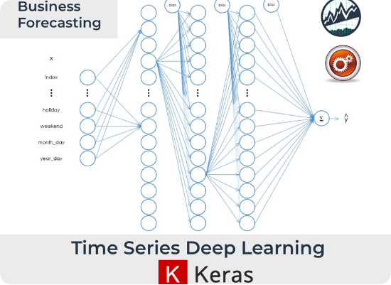
Sequence Building & Asset Embeddings
Multi-Step Forecasting
We convert raw data into sequences for the model:
Input (X): Past 30 Days (30 x 7 features)
Output (y): Next 5 Days Returns
Asset Embeddings
To differentiate assets in a single model, we map each Asset ID to a learned vector. This allows the model to learn "A 2% jump in BTC is different from a 2% jump in AAPL".

Slide 8
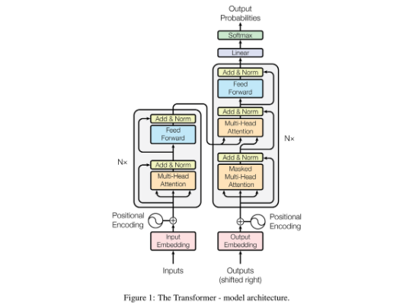
Transformer Architecture
Core Components
Input Projection: Converts raw features to model space.
Embedding Concat: Adds asset identity info.
Transformer Encoder: Uses Self-Attention to learn which past days matter most.
Pooling: Summarizes the sequence into a final state.
Output Layer: Predicts the vector of next 5 days.

Slide 9






Training Process
Data Split
Loss Function
Optimizer
80% Train / 20% Validation
Mean Squared Error (MSE)
Adam
Split chronologically to prevent future data leakage.
Penalizes large prediction errors efficiently.
Learning Rate = 0.001. Uses backpropagation through attention layers.

Slide 10


Advanced Experiments & Results
Zero-Shot Learning
Portfolio Simulation
We trained the model only on stocks and tested it on crypto.
Converted predictions into a trading strategy:
Predicted Return > 0 → Long
Result: The model achieved reasonable MSE on crypto without ever seeing it during training. This proves the model learned fundamental financial patterns rather than just memorizing specific assets.
Predicted Return < 0 → Short
Demonstrates the economic usefulness of the model beyond just statistical accuracy.

Slide 11
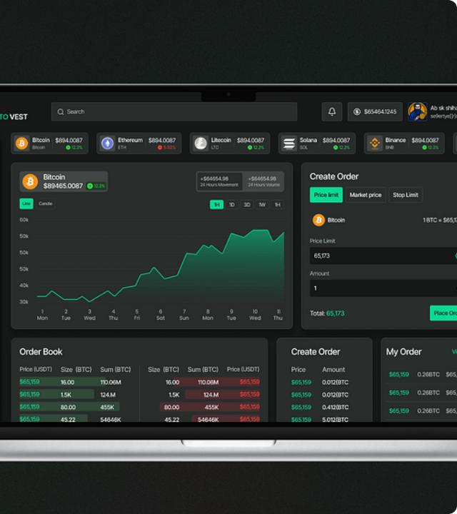
Streamlit Dashboard
We built an interactive dashboard to turn this theoretical experiment into a practical tool.
Forecast Visualization: View predicted vs actual returns.
Portfolio Tracking: Monitor simulated P&L.
Explainability: View Attention Heatmaps to see which past days the model focused on for transparency.

Slide 12

Questions?
Thank you for your attention.

Slide 13





Image Sources
https://static.vecteezy.com/system/resources/previews/005/922/913/non_2x/abstract-digital-hologram-finance-in-the-futuristic-background-cryptocurrency-and-modern-technology-transactions-in-online-systems-on-the-background-internet-stock-trading-financial-communications-vector.jpg
Source: www.vecteezy.com
https://png.pngtree.com/png-clipart/20250109/original/pngtree-stock-trading-monitor-with-market-charts-png-image_19340160.png
Source: pngtree.com
https://www.business-science.io/assets/2018-12-04-time-series/time_series_deep_learning.png
Source: www.business-science.io
https://miro.medium.com/0*Qb1YkJkJsh-OjoZg.png
Source: pub.towardsai.net
https://cdn.dribbble.com/userupload/43782042/file/original-0191db23ed26565b31edab8c03e8512f.png?resize=752x&vertical=center
Source: dribbble.com

